Slide 1
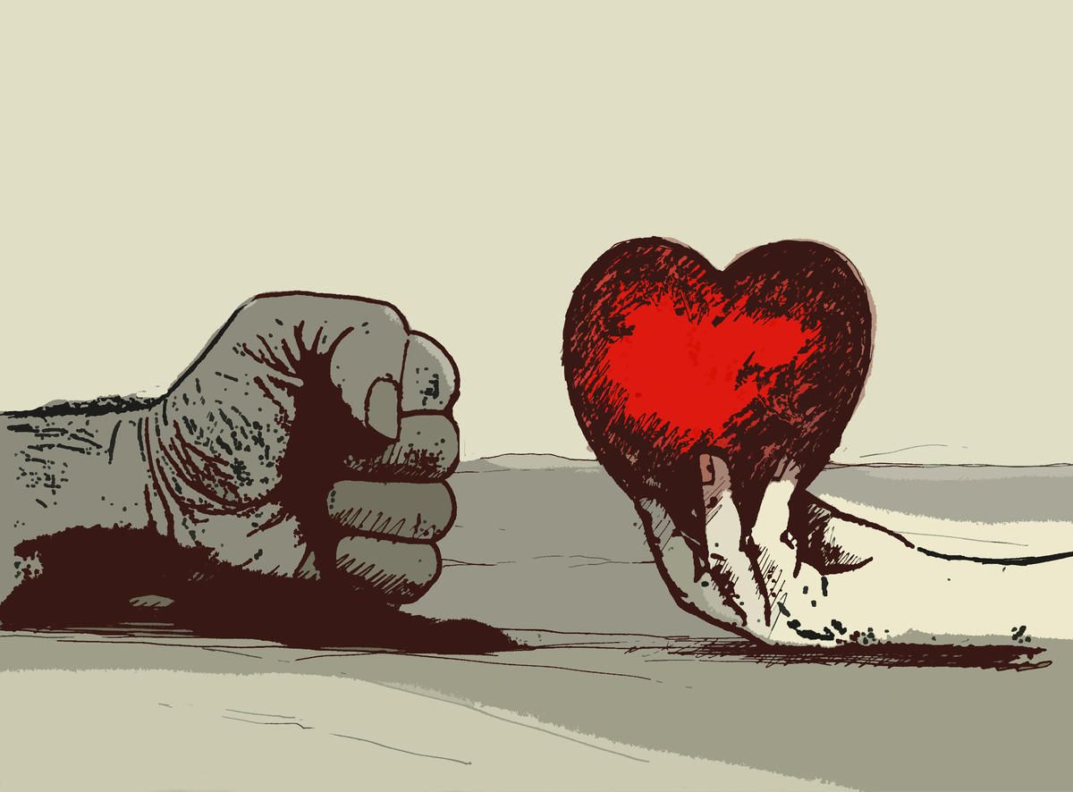
VIOLENCE AGAIST WOMEN
Realizzato da :
Mariachiara Tamburrino

Slide 2
STOP VIOLENCE !
If he threatens you
If he offenses you
If he hits you
If he controls you
If he follow you
THIS ISN’T LOVE

Slide 3
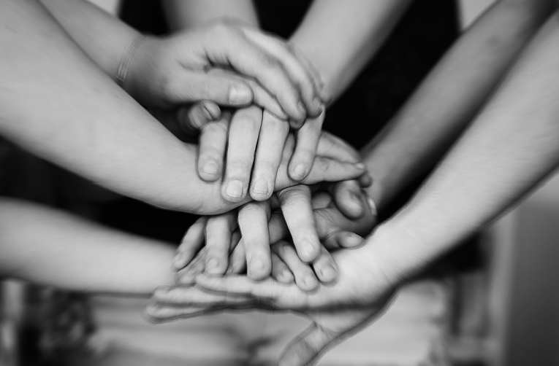
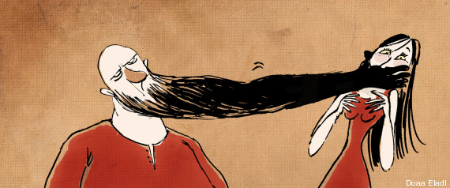
LIFE CAN BE A FAIRYTALE…
BECAUSE YOU AREN’T ALONE
IF YOU BREAK THE SILENCE

Slide 4

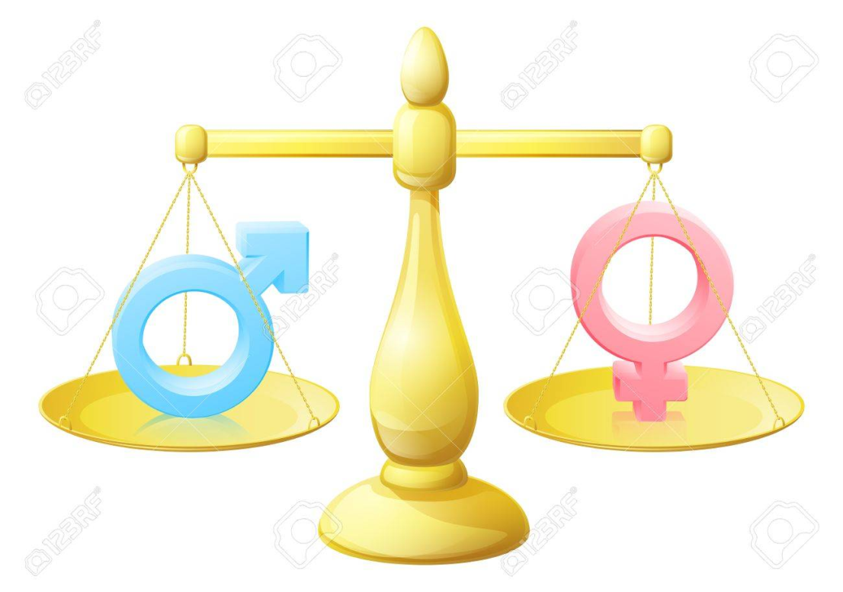
Gender equality
November 25th is the International Day for the Elimination of Violence Against Women.
In doing so, the United Nations invited governments, international organizations as well as NGOs to join together and raise public awareness every year on that date. Twenty years on, the battle to prevent and eliminate violence against women and girls around the world remains a challenge worldwide.
World Heritage is also concerned, as any other human environment, by this important matter.
Women play a crucial role in the identification, conservation, management and interpretation of World Heritage sites, and they make up a large proportion of the workforce in the communities in and around the properties including in tourism activities related to World Heritage.

Slide 5

SLOGAN
WHEN THE MAN ARRIVES TO THREATEN IN SILENCE DON’T STAY

