Slide 1
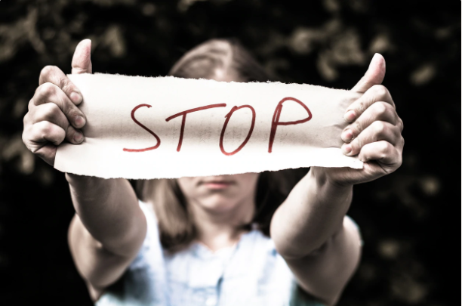
GLI ALUNNI DELLA 2D

Slide 2
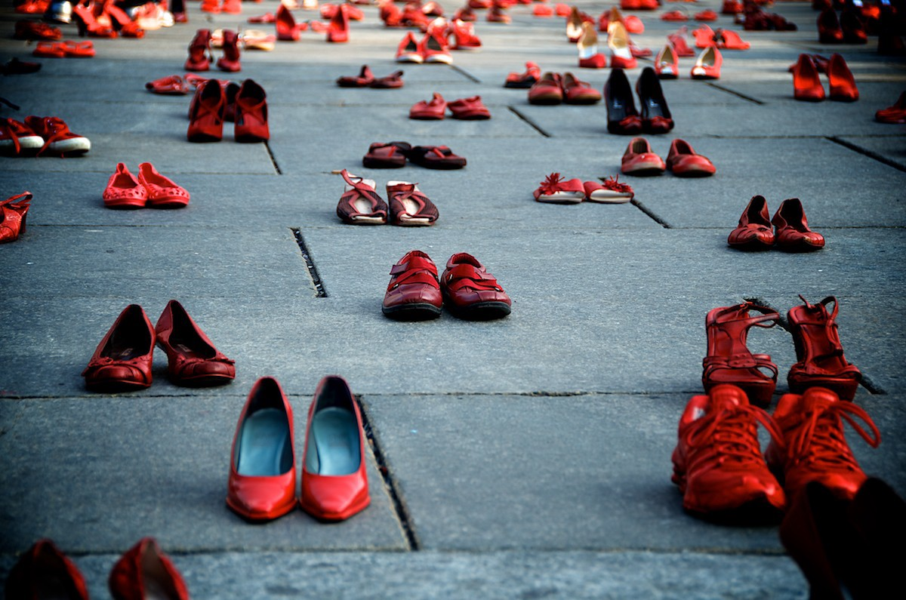
INTERNATIONAL DAY FOR VIOLENCE AGAINST WOMEN
Violence against women, also known as sexual and gender-based violence, are violent acts committed exclusively against women or girls. Violence against women has a very long history, although incidents and intensity have varied over time and even today vary between societies and can stem from a sense of right and superiority, especially against women.

Slide 3
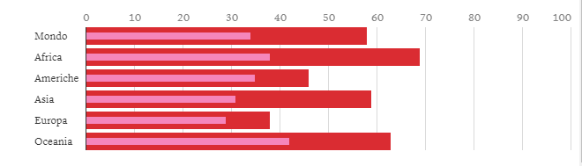
IN RED: WOMEN KILLED BY THEIR PARTNER OR BY A RELATIVE.
IN PINK : WOMEN KILLED BY THEIR PARTNER

Slide 4
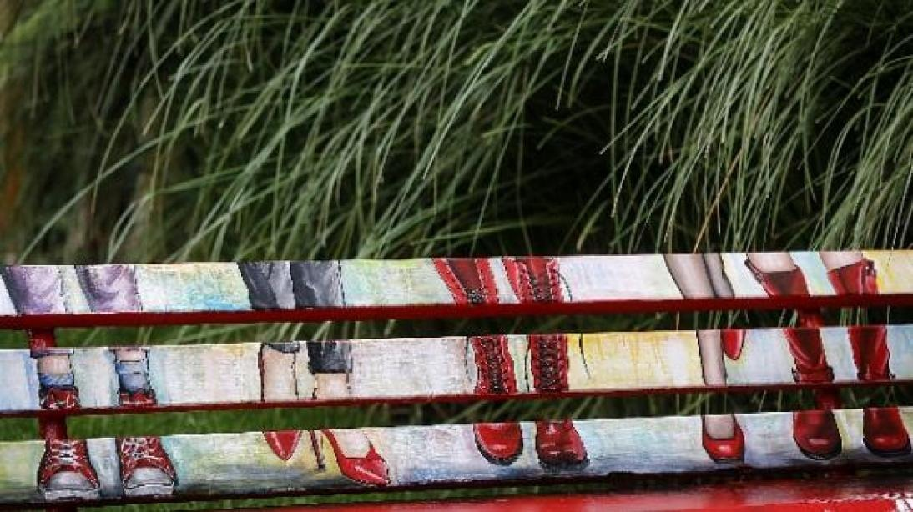
MEN ARE AFRAID THAT WOMEN WILL LAUGH AT THEM .
WOMEN ARE AFRAID THAT MEN WILL KILL THEM
Nicola Pirozzi
MEN CAN’T BE CALLED “MEN” IF THEY CAN’T MAKE WOMEN FEEL LOVED
Maria Tessitore
WOMEN ARE MADE TO BE LOVED,NOT TO BEN BEATEN.
Giusy Palomba
DO NOT USE VIOLENCE AGAINST WOMAN
Daniele Mauro Tommasino
WHENEVER A WOMEN FIGHTS FOR HERSELF, SHE FIGTHS FOR ALL WOMEN
Giuseppe Sabatino

Slide 5
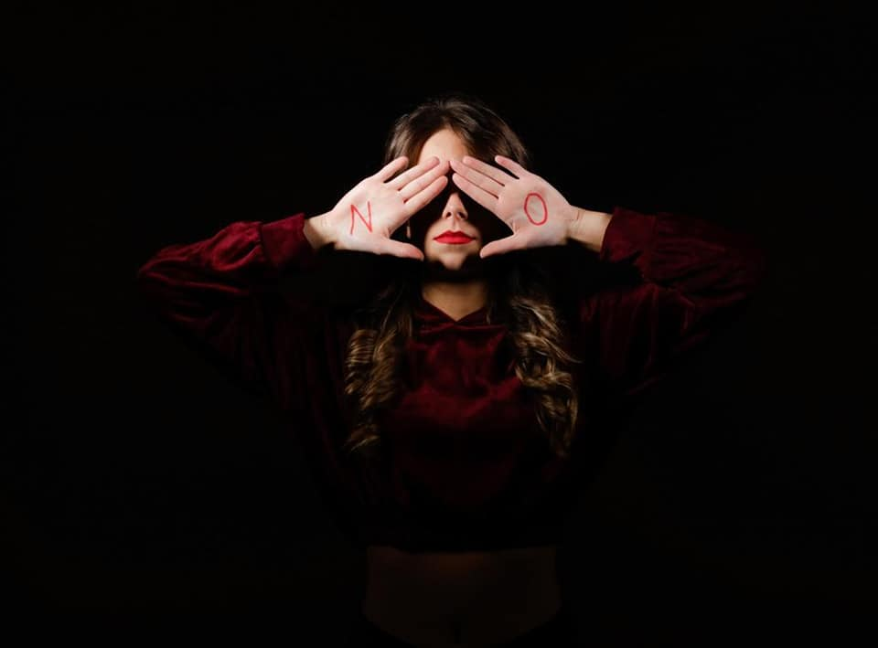
WE SAY STOP!

