Slide 1
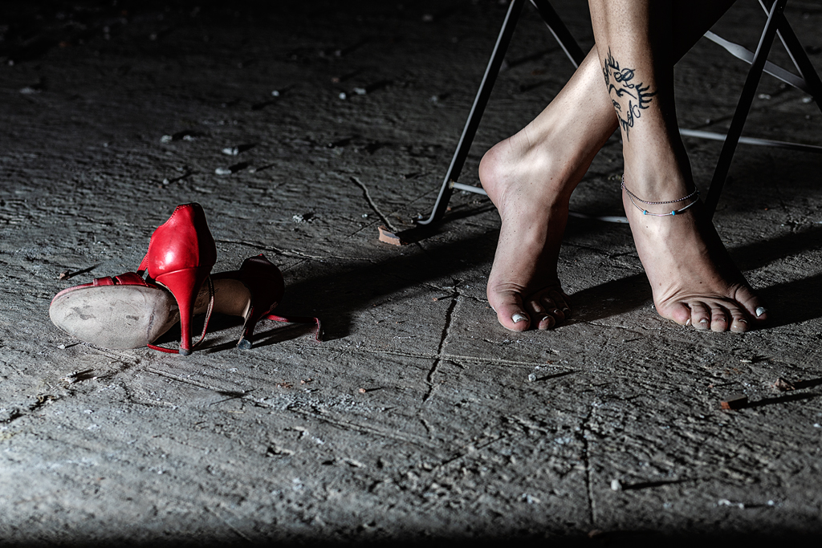
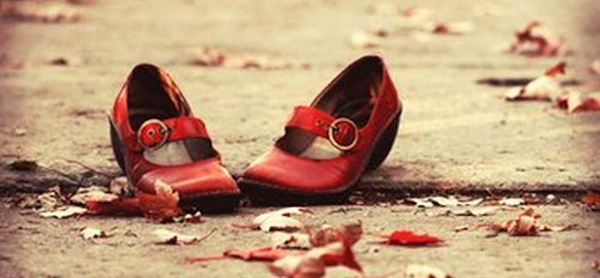
No to violence against women
On 25 November, the International Day for the Elimination of Violence Against Women was established by the United Nations General Assembly, international organizations and ONG to combat inequality and abuse. Indeed, despite the great progress made in the field of equality, women often continue to find themselves in situations of inequality, submission and violence.
Red shoes are used on November 25 as a symbol against femicide. Wearing a pair of red shoes symbolizes our edition to a struggle that must see us all united, for all the blood shed by so many women and to say stop to violence.

Slide 2
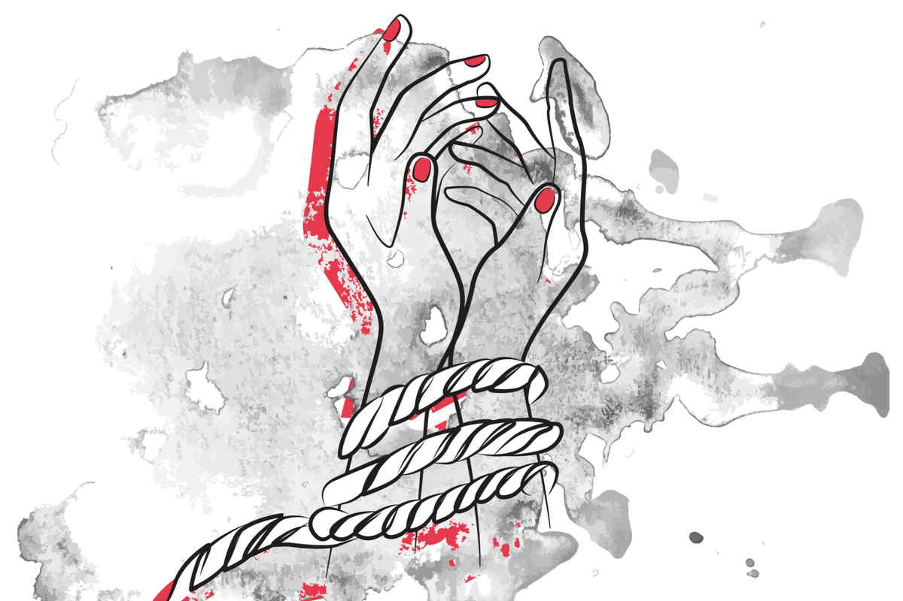
For all the violence against her,
For all the humiliations she has suffered
For her body that you have exploited,
For her intelligence that you have trampled on,
For the ignorace in which you left in,
For the liberty you denied her,
For the mouth you have closed,
For her wings that you clipped her,
For all of this: stading, men, in front of a WOMEN

Slide 3


Dear women ... Love yourself
And arm yourself
with scissors to cut The wires that bind you to
people That hurt you !!. let yourself be loved by those who
Know how to conjugate this verb...
No more excuses,
Stop postponing
Stop waiting and waiting
Love is not an eternal justification !

Slide 4
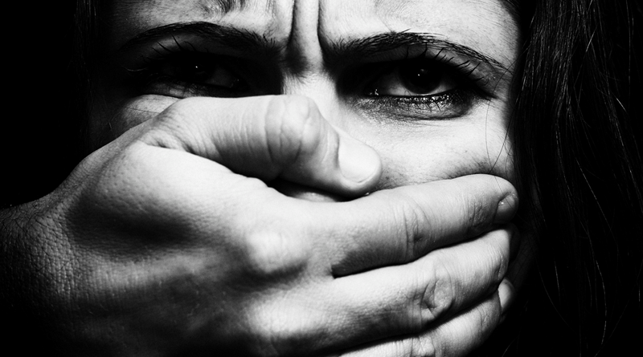
It may seem
obvious to say "NO", but
as long as there is need
of a day
international against
violence on
women means that
our "NO" not
they will still have been enough.

Slide 5
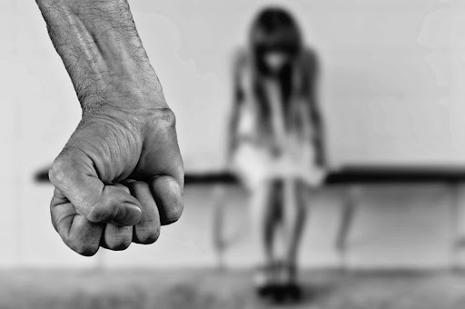
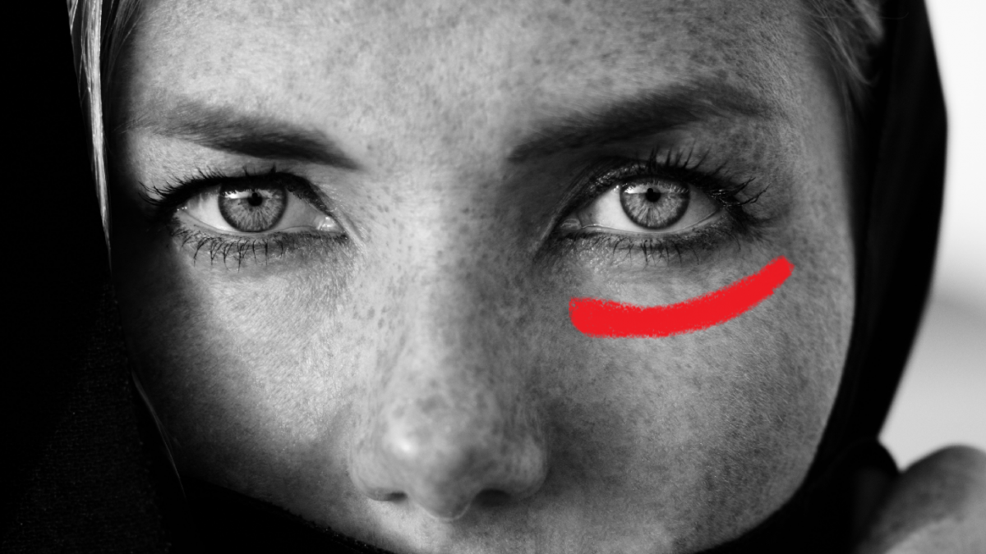
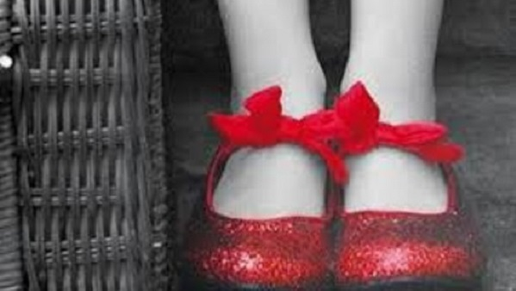



Slide 6
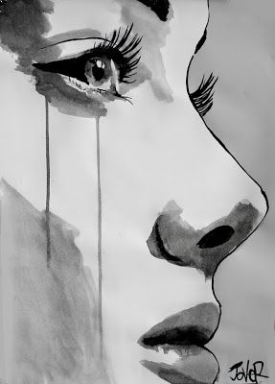


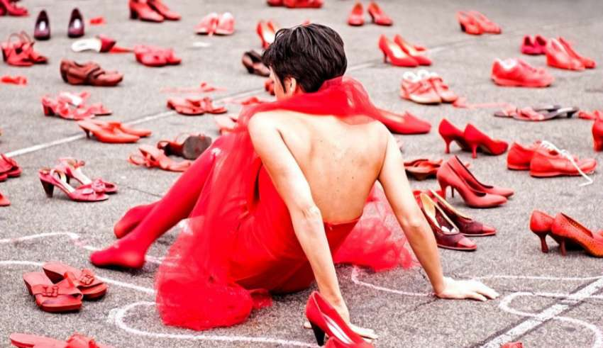
Work done by:
Chianese Antonia
Carpentiero Chiara
Pezone Nicola
De Luca Giovanni

